Slide 1

Work Related learning
Week 4-The big issues in Health and Social Care before Covid 19 & the negative impact of covid 19 on the UK health and social care sector

Slide 2
Module lecturer-Tayo Alebiosu
Health and Social Care
Work Related learning
Contact me: tayo.alebiosu@lsclondon.co.uk

Slide 3

Last session recap (10 minutes)
Students ….
1. Explored the context of the CoVid19 pandemic
2. Highlighted the positive impact of covid 19 on the UK health and social care sector

Slide 4
Aim:
Analyse the nature of the Health and Social Care sector or industry in its wider context and specific environment
Today’s Learning Outcomes:
At the end of the class, the students will be able to ;
1-Identify the big issues in Health and Social Care before Covid 19
2- Highlight the negative impact of covid 19 on the UK health and social care sector

Slide 5
What are the Big issues in Health and Social Care sector before covid 19?

Slide 6
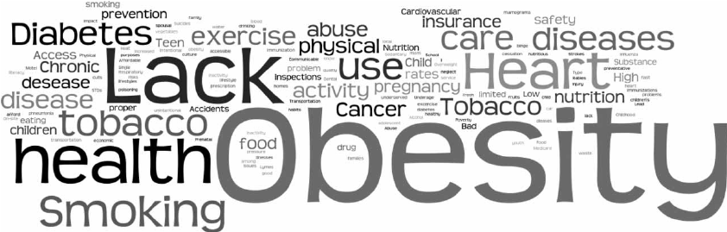
What are public health issues in UK?
Health and social care funding
NHS performance and waiting times
Health and Social Care Workforce
Rough sleeping.
Air pollution.
Alcohol.
Bowel cancer.
Cardiovascular disease prevention.
Cervical screening.
Child dental health
(Click the below link for more public health issues)
www.gov.uk › government › collections › health-matters-public-health-i
Health matters: public health issues - GOV.UK

Slide 7
Top global health issues
Global Health Security.
Malaria
Polio
Measles
Tuberculosis (TB)
Climate crisis
Health care delivery in areas of conflict and crisis
Environmental Quality
Global Health Security
Climate crisis
Tobacco
Substance Abuse
Covid 19
Physical Activity and Nutrition
Overweight and Obesity
Tobacco
Substance Abuse
HIV/AIDS
Mental Health
Injury and Violence
Infectious disease prevention
Overweight and Obesity
Neglected Tropical Diseases

Slide 8

Aim
Analyse the nature of the Health and Social Care sector or industry in its wider context and specific environment
Learning Outcomes:
1. Explore an overview of literatures on the health and social care sector with discussions on the wider context of the CoVid19 pandemic
2. Covid 19 as issues impacting health and social care in the 21st century

Slide 9

STARTER
(15 minutes)
Individually, using your mobile device, conduct a research to identify the difference between health care and social care.
Feedback by explaining your findings

Slide 10
ASSESSMENT SUBMISSION
Date assignment set | April 2021
Submission deadline date | 12th July 2021
Return date to students | 9th August 2021
All assignment will be submitted in electronic format and uploaded to LSC Portal on Turnitin

Slide 11
Assessment methods
The assessment Guide for Work Related Learning (WRL) has one (1) summative component:
Individual Report (weighted 100%)
Tasks to be completed (of not more than 2500 words)
Collate an individual report which assesses the health and social care sector, taking into account the current situation of the CoVid19 pandemic.
Explore how this has impacted the career prospects for health and social care.
Evaluate an organisation as an exemplar to justify your stand, by applying the theories and models learned from this module.

Slide 12

LO2 Activity
Individually, research the impacts of Covid 19 on the health and care system’s using the NHS as a National key perspective.
Feedback by explaining your findings

Slide 13

For the first time in history, a health crisis has shut down the entire global economy, painfully demonstrating how inseparable healthcare and the economy have become.

Slide 14

Coronavirus—now officially known as COVID-19—likely won’t be as disastrous as that particular prediction, but there have been 45,171 confirmed cases globally across two dozen countries, and 1,115 people have died.
It has global health officials very concerned about just how prepared we are for this or any other pandemic. On January 31, 2020, the World Health Organization declared the outbreak a Public Health Emergency of International Concern.

Slide 15

Cont.…
In another blow, the pandemic threatens to set back hard-won global health progress achieved over the past two decades - in fighting infectious diseases, for example, and improving maternal and child health.
So in 2021, countries around the world will need to continue battle COVID-19 (albeit with the knowledge that effective tools are evolving).
They will need to move swiftly to repair and reinforce their health systems so they can deliver these tools, and to address the key societal and environmental issues that result in some sections of the population suffering so much more than others.

Slide 16

The impacts of COVID-19 to date have been significant on health, the economy and society. As with many other diseases, COVID-19 has a more severe impact on vulnerable groups, including older people, people with disabilities, ethnic minorities and those living in deprived areas.
Allowing the virus to grow exponentially would lead to impacts, in terms of loss of life and ill health, that would be considered intolerable for society.

Slide 17

LO 1 activity
Individual activity
How does covid 19 impact on the UK health and social care system??....
Let's talk about it …..
Students to individually make their own contributions to the discussion

Slide 18
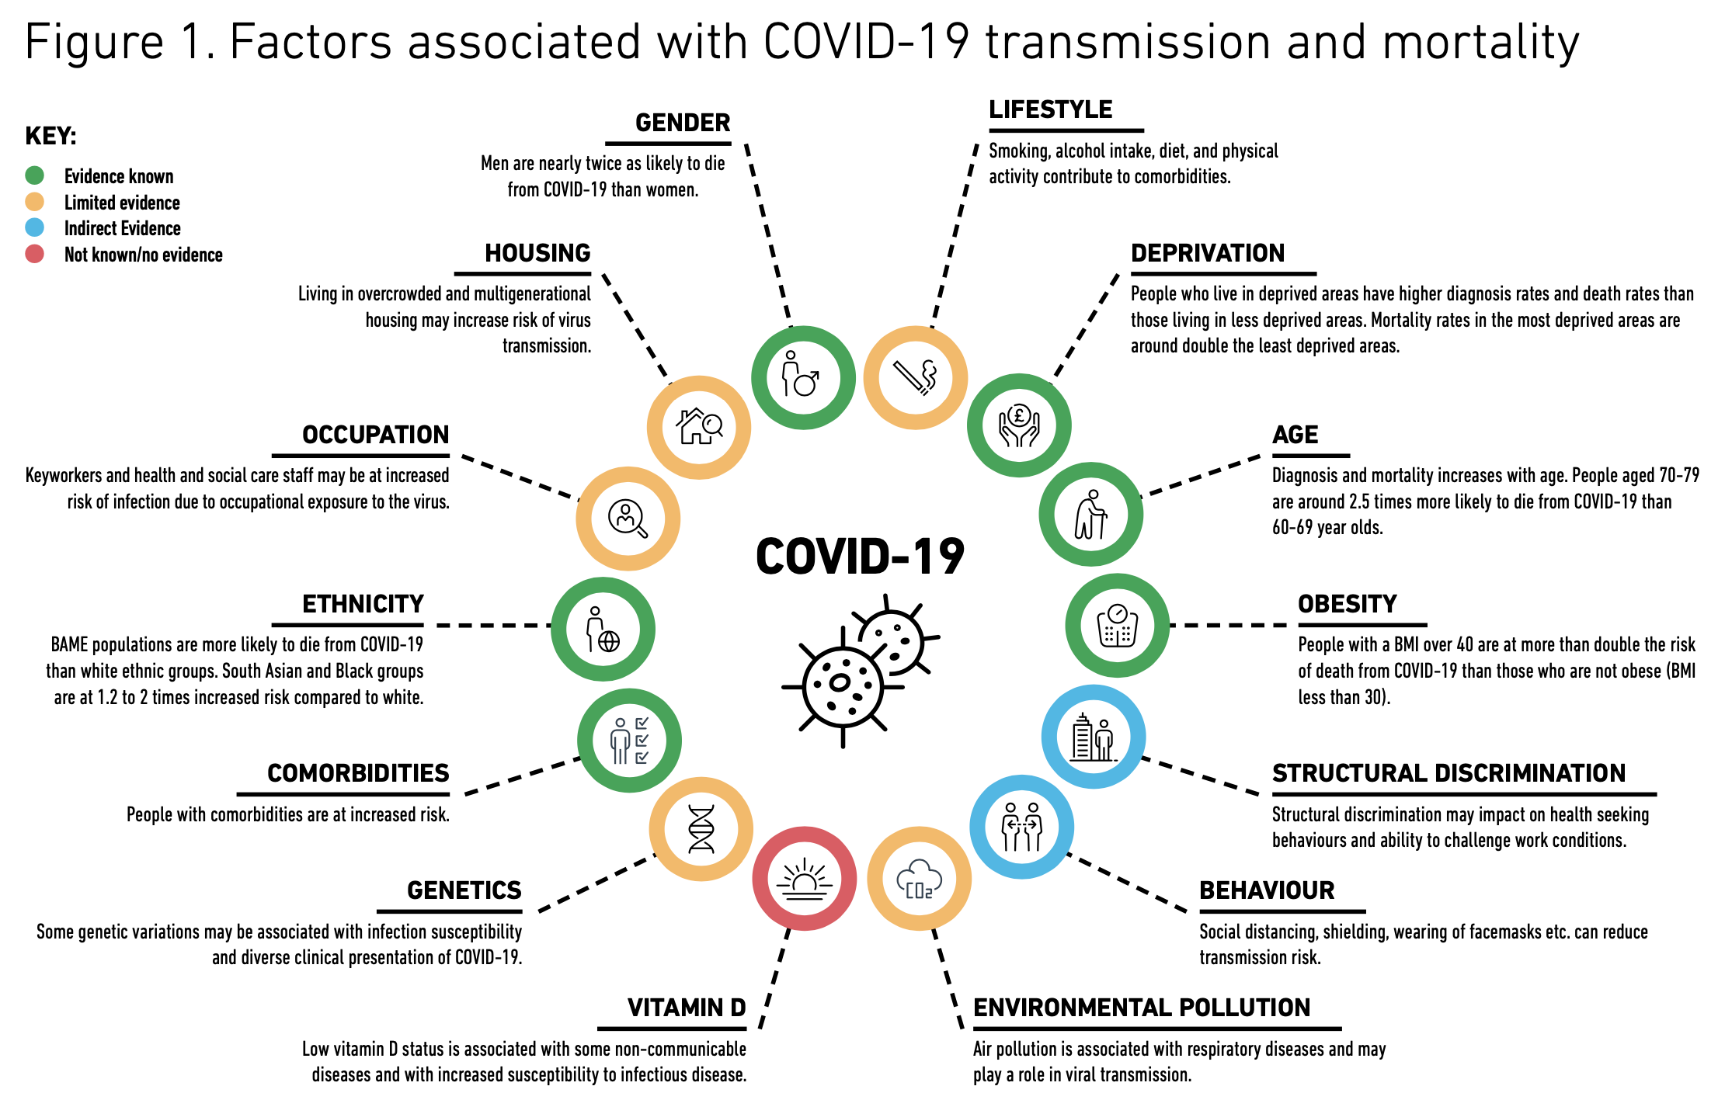
COVID-19 in Black, Asian and Minority Ethnic populations: An evidence review and recommendations from SAHF (2020).
Available at: https://www.sahf.org.uk/covid19

Slide 19

Impact of Covid 19 on Global Healthcare
2020 was a devastating year for global health. A previously unknown virus raced around the world, rapidly emerging as one of its top killers, laying bare the inadequacies of health systems.
Today, health services in all regions are struggling to both tackle COVID-19 and provide people with vital care.
The COVID-19 pandemic has exposed vulnerabilities even in health systems that had been considered strong, such as those in Spain and Italy.
Around the world, the pandemic has also highlighted the indelible link between citizens’ health and the strength of economies.

Slide 20

Impact of COVID-19 on patient care in the NHS in England
The full impact of this drastic reduction in routine NHS care in England is only now emerging. Millions of patients living with health problems (including life-threatening conditions such as cancer) have been affected, with their treatment postponed or cancelled.
Millions of patients will have missed vital opportunities to receive initial assessment and diagnosis for health problems in the first place. This is the hidden impact of the COVID crisis – patient safety is being severely compromised not just by the virus itself, but by the knock-on effects of an unprecedented disruption to NHS services.

Slide 21
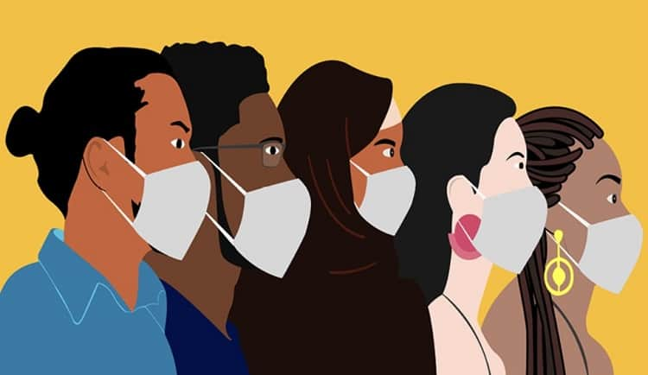
Inequalities Exposed
The crisis also had the impact of exposing the deep levels of inequalities which exist in society, with evidence telling us that Black, Asian and minority ethnic (BAME) communities, adults with learning disabilities, and those on the lowest incomes, have been disproportionately affected.
Ethnic minority groups will need targeted support as they are at higher risk due to racism, stigma, poor housing, key worker roles, and multigenerational households.

Slide 22
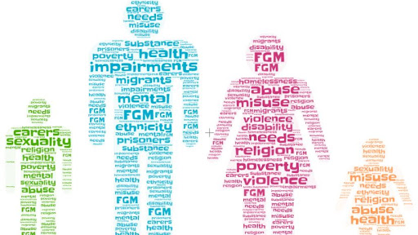
Society's most vulnerable people- increased risk of contracting COVID-19
Unsurprisingly, the social care sector has been hit particularly hard by the coronavirus pandemic. Society's most vulnerable people, such as the elderly, have an increased risk of contracting COVID-19 and this has put huge pressure on the sector, as these vulnerable groups rely most heavily on social care services.
By June 2020 there had been more than 30,500 excess deaths among care home residents, with social care staff more than twice as likely to die from COVID-19 as other adults. The pandemic has highlighted inequalities in society (people from ethnic minority groups are more likely to die of coronavirus than white people), the social care industry's fragile finances and the low pay and poor conditions experienced by many workers.

Slide 23

Delayed local response
During the first few weeks of the pandemic, people who use services and carers told us that they often felt very isolated and frightened.
Whilst some local authorities were good at contacting people quickly, in other areas people didn’t hear from their key workers for many days.
Information on websites about, for instance direct payments, was often slow to be updated.
Although many local authorities were praised for the support they gave to providers, others were criticised for being slow and inflexible, for instance, not passing on funding quickly to struggling providers.

Slide 24


10 minutes break

Slide 25
Impact on patient care regarding capacity
This outcome was avoidable. Although a pandemic on the scale of COVID-19 was always likely to cause major disruption to health services, the drastic extent to which the NHS had to shut down routine care is a consequence of over a decade of underinvestment and (in the case of public health and social care) cuts to services.
As a result, NHS capacity has lagged behind many other EU countries, including in terms of bed numbers, critical care facilities, workforce numbers (with 10,000 medical vacancies in the NHS in England in 2019) and resources in primary and community care. The NHS was already in crisis before the pandemic hit, as the BMA consistently warned.
As the NHS begins the vital task of reopening non-COVID services, it now faces a huge backlog of unmet patient need, with patients now facing long waits for treatment.

Slide 26
The COVID-19 crisis has also caused issues surrounding:
Quality of Care - Reduced staff availability (due to sickness), a lack of personal protective equipment (PPE), and people being discharged from hospital (in the rush to free up space) to services that don't fully meet their needs have all impacted the quality of care that services within the sector provide.
Disjointed Care - A longstanding challenge of the social care system is the ability to transfer people from hospital to alternative care settings successfully. Because of the need to free up hospital beds quickly at the height of the pandemic, there's concern about whether people were always discharged to the right place.

Slide 27
Unmet Need
- As a result of the virus and the measures put in place to help stop it spread some services were reduced, suspended or cancelled to ensure that the most critical care could be provided.
For example, day centres were suspended to comply with social distancing and the Age UK Home Help service closed as the safety of staff and service users couldn’t be guaranteed.

Slide 28

COVID-19: Five dimensions of impact
Direct impact of the virus itself
The first dimension is the direct impact of the virus itself, in terms of death and serious illness. The early evidence from China (and subsequently Italy), suggested that the virus was more likely to kill those who were older, had underlying conditions (especially hypertension, diabetes and ischaemic heart disease), and were male. The pattern in England, Wales and Northern Ireland is the same for patients with COVID-19 needing intensive care.

Slide 29
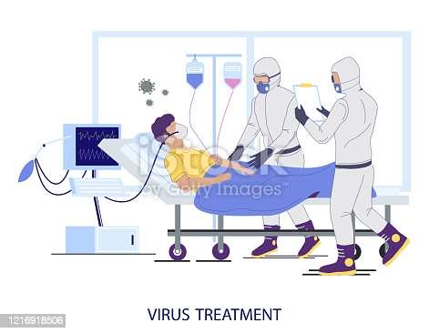
Impact on acute care
The second dimension of concern is the indirect impact on people with acute conditions not related to COVID-19. During March 2020, NHS trusts rapidly re-designed their services on a large scale to release capacity for treating patients with COVID-19.
This included discharging thousands to free up beds, postponing planned treatment, shifting appointments online where possible and redeploying staff, a process covered widely in the media. NHS England published more than 50 sets of guidance to hospital specialists for the treatment of non-COVID-19 patients during the pandemic (COVID-19: Five dimensions of impact | The Health Foundation, 2021)

Slide 30
Non-acute care including general practice
A third dimension of disruption will affect people with chronic conditions, or people needing less urgent care which may have been interrupted. General practice does much of the work of managing patients with chronic conditions.
From mid-March, the way general practice works has profoundly changed: according to the guidance, all practices should have moved to remote triage, where patients are assessed by phone or online before they can access a GP or other health professional.
To free up capacity, GP practices were given the option to defer some routine activities, including health checks for the people aged 75 and older and routine medication reviews. Other activities, such as child immunization’s, should have continued.

Slide 31
Cont…
At the same time, the public were given instructions to access NHS 111 rather than their GP if they had COVID-19 symptoms.
Understanding how this has affected access to general practice will be critical. A key factor will be the ease with which general practices have been able to move to online working (the Royal College of General Practitioners reports that many practices are struggling with basic IT hardware and software), and whether an appropriate level of patient contacts has been maintained (COVID-19: Five dimensions of impact | The Health Foundation, 2021).

Slide 32
The lockdown and social distancing
The fourth dimension will be the medium and long-term impact on health of the government interventions to restrict movement to curb the transmission of COVID-19. The impact directly caused by the lockdown could be profound, for example resulting in bankruptcies, unemployment, more domestic abuse, neglect and hardship.
There are also the social consequences of a prolonged lockdown and period of social distancing: surveys show increases in anxiety and charities highlight a rise in people seeking help for domestic abuse. School closures may have negative and unequal consequences for pupils’ development.
(COVID-19: Five dimensions of impact | The Health Foundation, 2021)

Slide 33
NHS and social care capacity and resilience
The fifth dimension is the longer term impact on service capacity and resilience.
The NHS entered the pandemic with a relatively low level of beds and staff per capita, and much of the policy response to the pandemic has hinged on slowing infections to allow time for the NHS to increase critical care capacity in hospitals.
Regions within England did not start at the same place, with London having more critical care beds per capita than elsewhere.
As a whole, the NHS mobilised a large number of additional critical care beds and equipment.
However, it will be important to track hospital admissions data over time, to understand what impact this has had on capacity within hospitals across all regions, for both COVID-19 and non-COVID-19 activity.

Slide 34
WRAP-UP
Question and Answer Session

Slide 35
Cont…
Specific measures are necessary to protect children and women living in poverty and those at risk of domestic violence.
As we reset and rebuild social care, it is vital that we proactively tackle historic inequalities and injustices, whilst ensuring that the new models of care that are nurtured and developed as a result of the reforms are equally relevant, accessible and vital to all groups.

Slide 36
Summary
In this section, learners were able to:
Identify Covid 19 National strategies for Healthcare and Covid 19 National strategies for Social Care
Explain the difference between Covid 19 National strategies for Health Care and Covid 19 National strategies for Social Care

Slide 37

End
This session has ended. Thank for your attendance and active participation. IT’S ALL ABOUT YOU !

Slide 38
In conclusion, we have learnt how to:
1-Explore the international and Global Perspectives Context of Health care delivery.
2-Explain the National contextual Perspectives of Health care delivery
3-Identfy the local contextual Perspectives of Health care delivery.

Slide 39
Glossary of different health care Perspectives
BMA: British Medical Association
CCG: Clinical Commissioning Groups
DCN: District Councils Network
DPH: Director of Public Health
GP: General Practitioner
HWB(s): Health and Wellbeing Board(s)
JSNA: Joint Strategic Needs Assessment
JHWS: Joint Health and Wellbeing Strategy
RCN: Royal College of Nursing
LSHTM: London School of Hygiene and Tropical Medicine
NHSE: NHS England
PCT: Primary Care Trust
PHE: Public Health England
PHOF: Public Health Outcomes Framework
PRUComm: Policy Research Unit in Commissioning and the Health Care System
UKFPH: UK Faculty of Public Health

Slide 40
https://www.scie.org.uk/care-providers/coronavirus-covid-19/beyond/adult-social-care/negative-impacts
doi: https://doi.org/10.1136/bmj.m3944
DOI:https://doi.org/10.1016/S2213-2600(21)00068-0

